Slide 1
Instructions to users
2026-03-23

Slide 2
Content
1 Introduction
2 Installation
3 Running the tool
4 Validation test
5 glTF Output

Slide 3
I Introduction
This tool is developed for identifying fire hazard. Currently the tool only support Revit 2018.

Slide 4
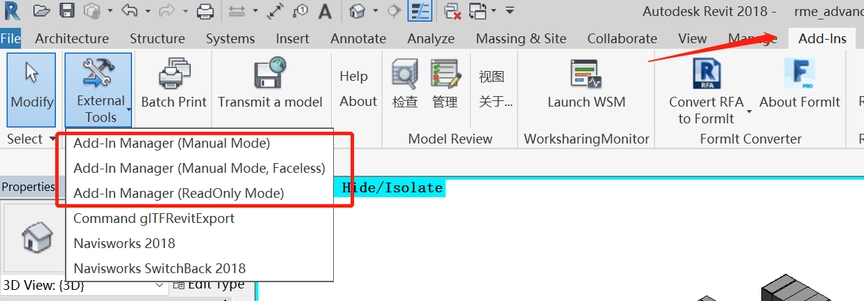
2 Installation
The tool is run by the Revit Addin Manager, which is an add-in for Revit. If you have not install the Addin Manager, please quit the Revit application, copy all the files in the AddinManager to the folder C:\ProgramData\Autodesk\Revit\Addins\[your Revit version]\, and restart the Revit application. Then you can find it appears in the Add-Ins Tabs

Slide 5
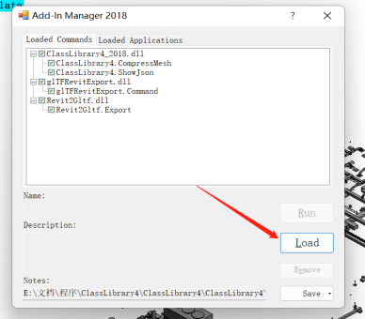
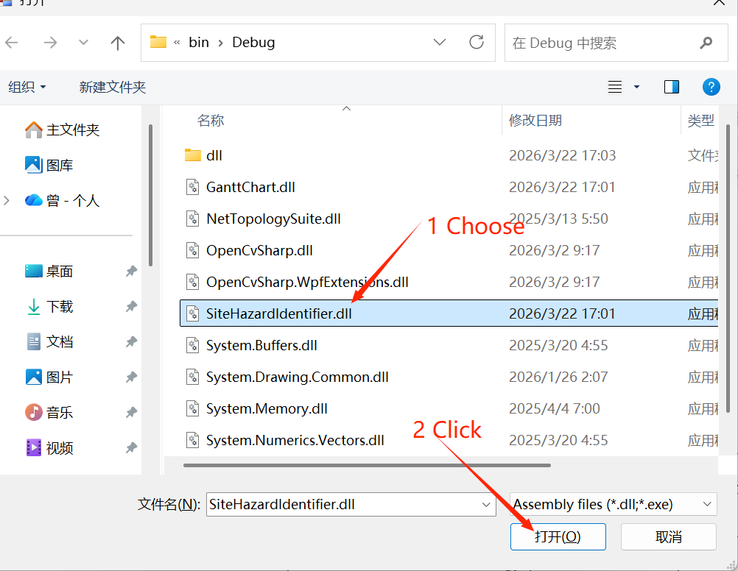
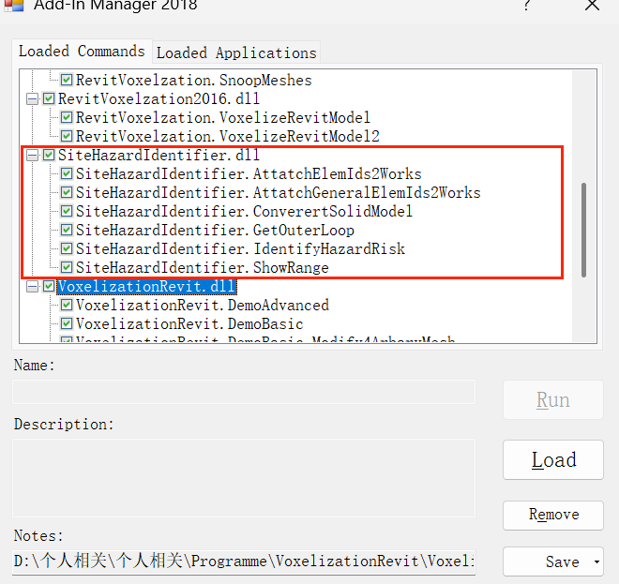
2 Installation
Click the “Add-In Manager（Manual Mode）” , Click “Load”, choose the SiteHazardIdentifier.dll of "Supplementary Materials\Compiled\Debug\" folder

Slide 6
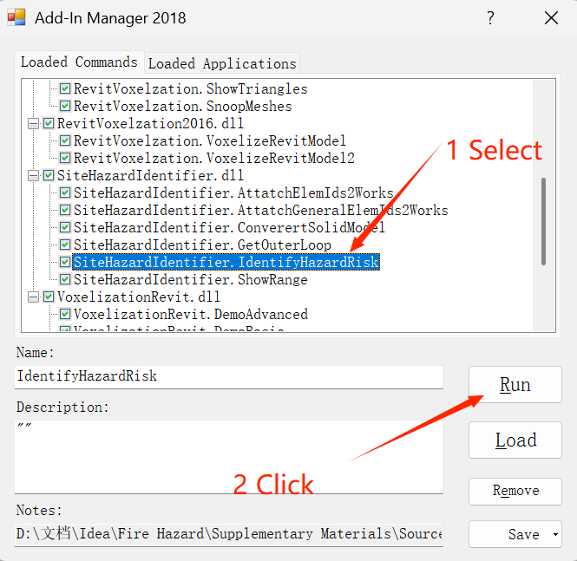
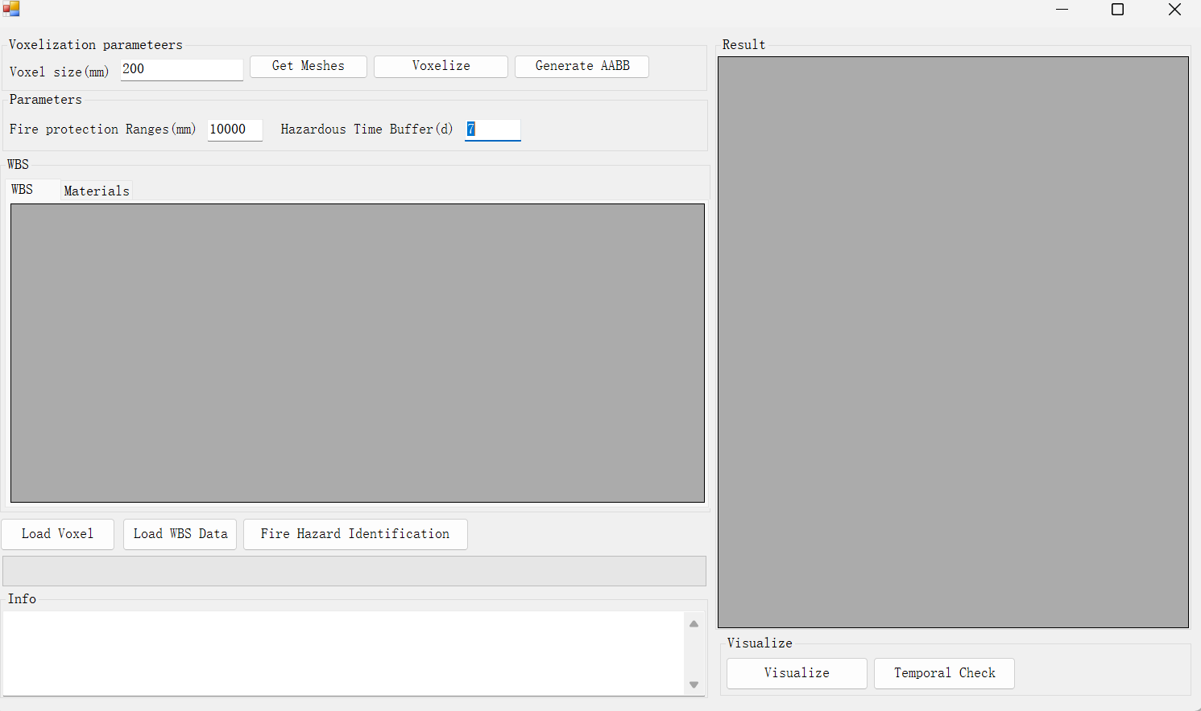
Running the tool
1st Select the SiteHazardIdentifier.IdentifyHazardRisk from the Add-in Manager, then click Run. The main form of the tool will appear.

Slide 7
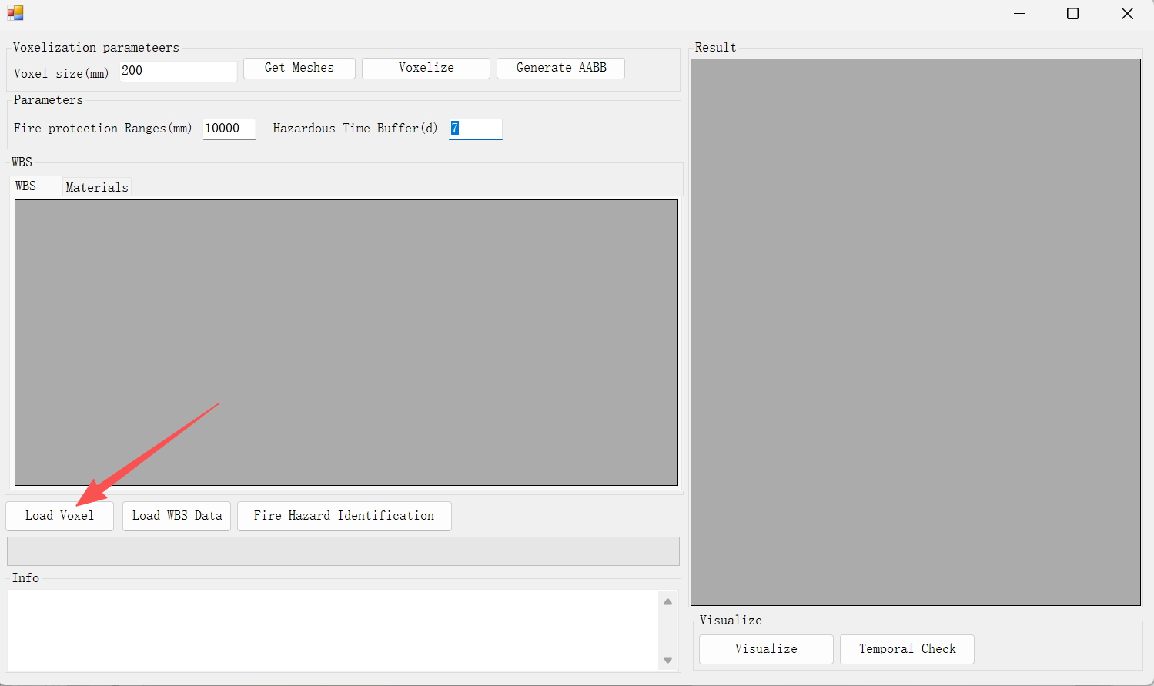
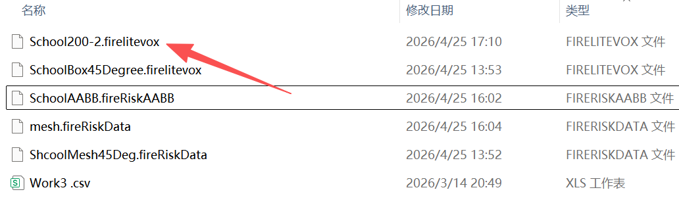
Running the tool
2nd click the “Load voxel”. Choose the “School200-2 from the SampleFile folder. Wait until the voxels are loaded.

Slide 8
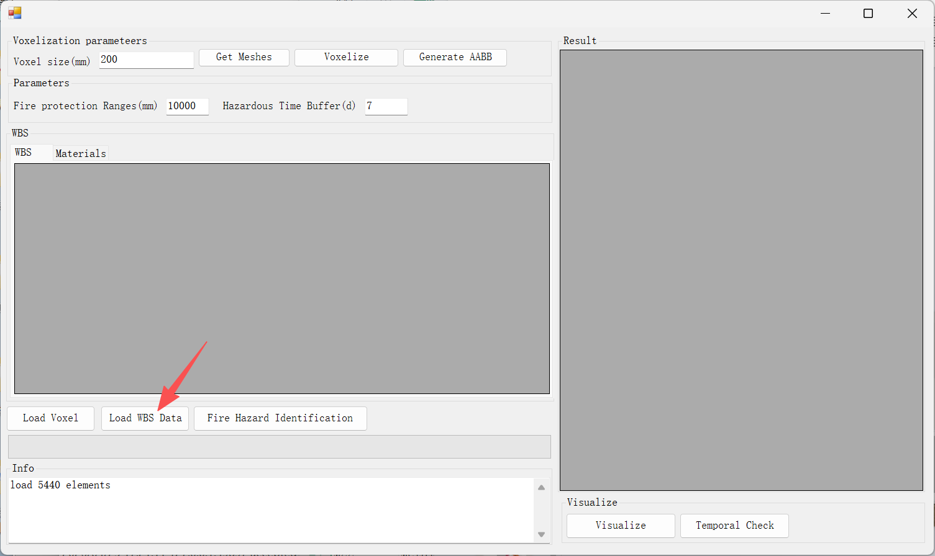
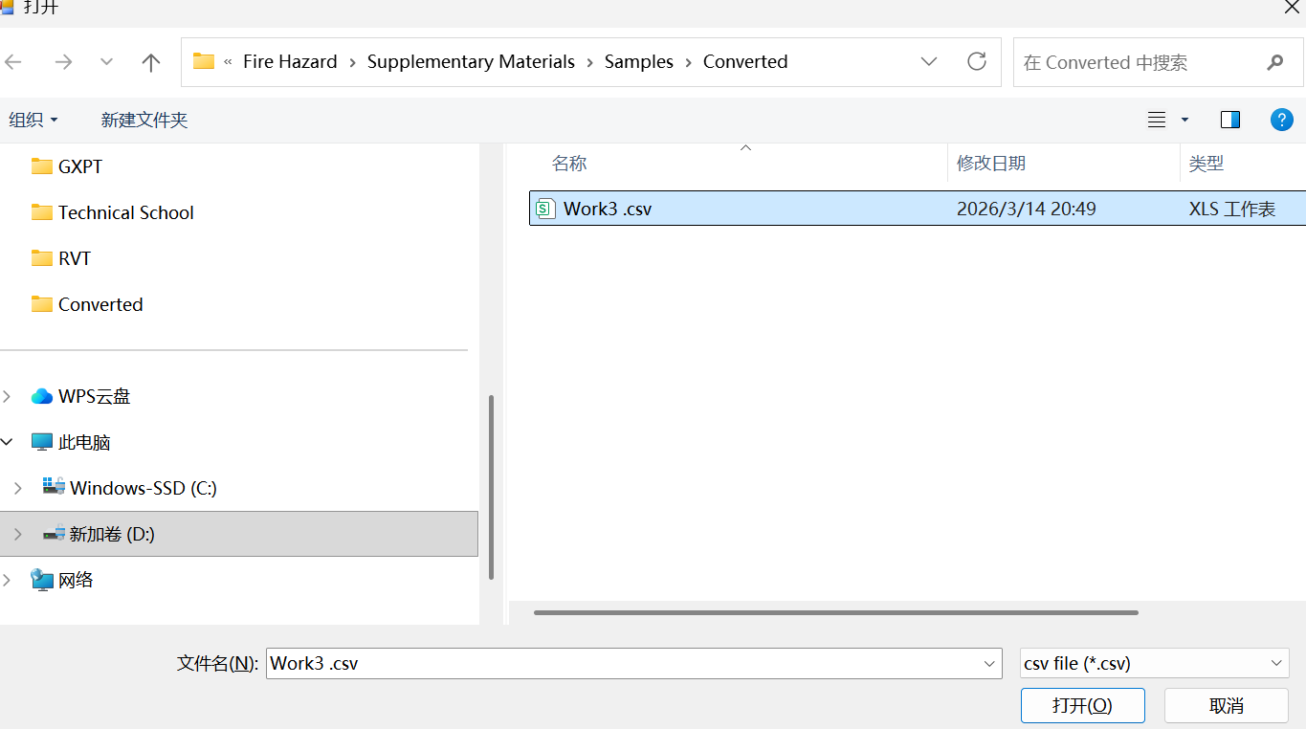
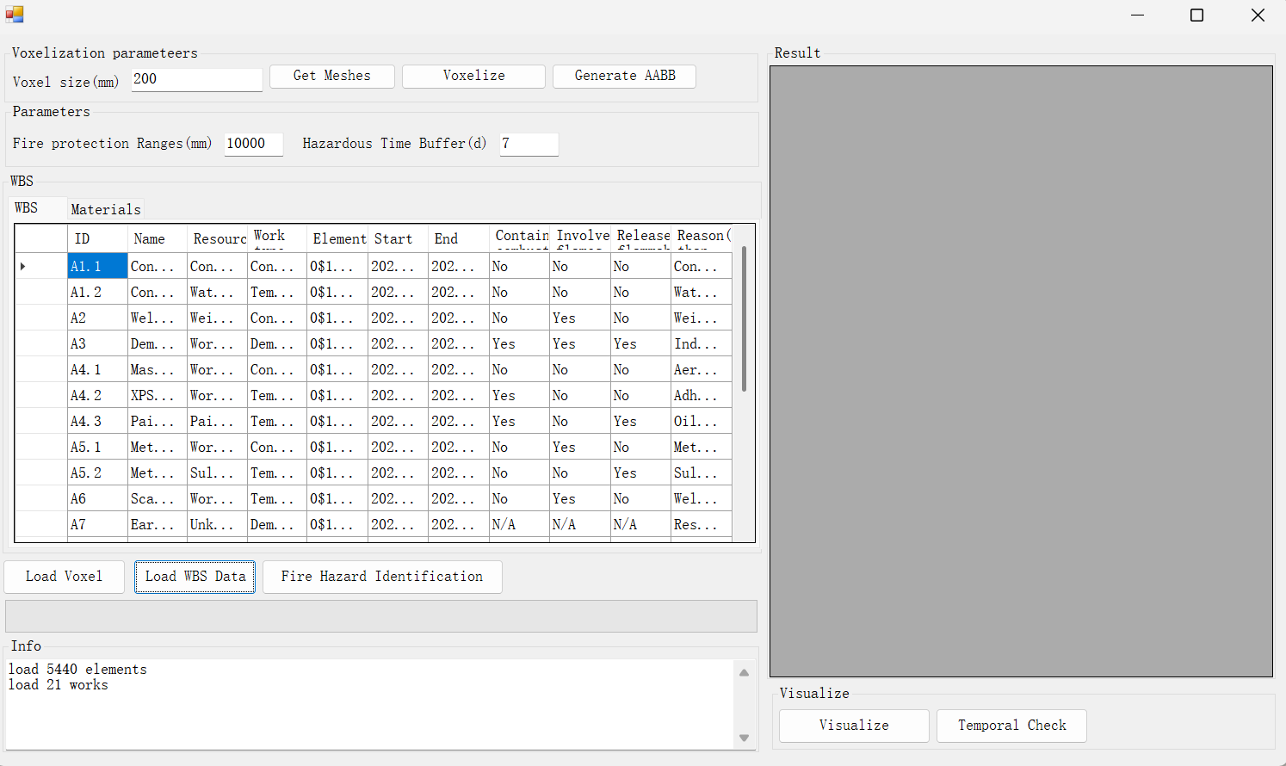
Running the tool
3rd, Click the “Load WBS Data” button, choose the Work3.csv from “Supplementary Materials\Samples\Converted” folder. Wait until the data are loaded.

Slide 9
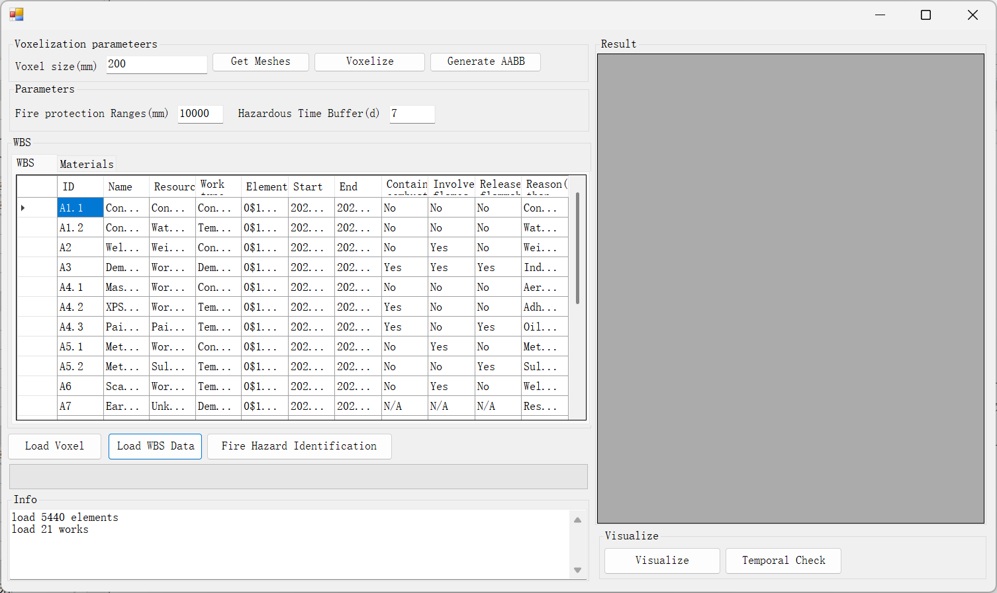
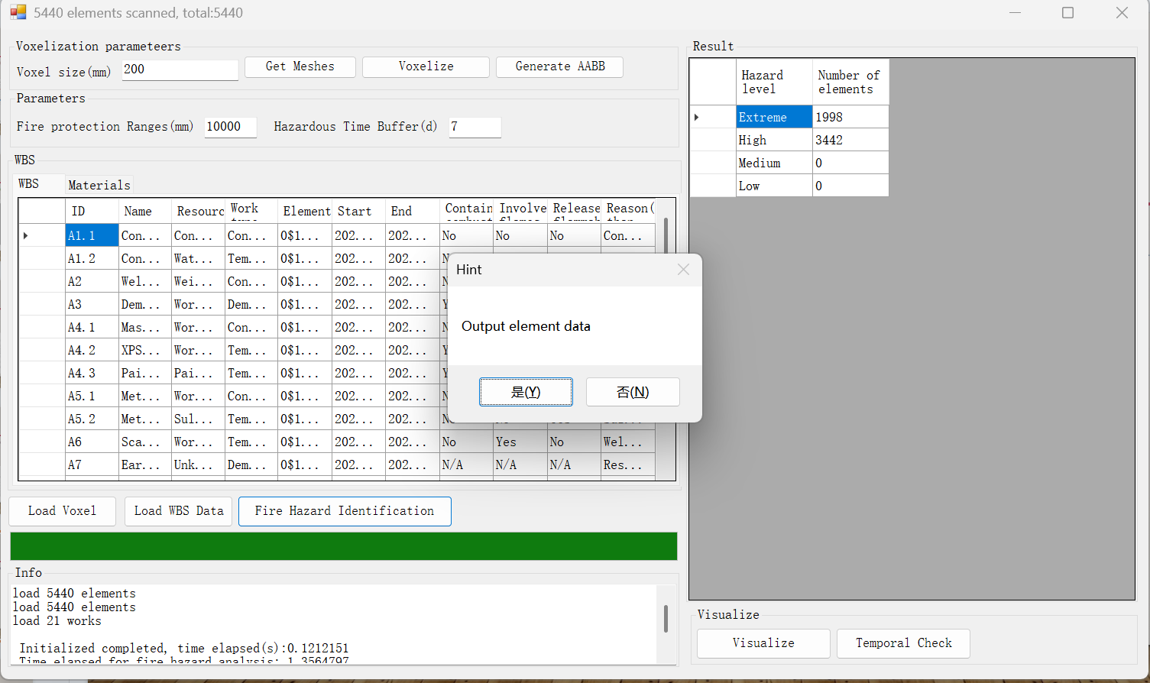
Running the tool
4th Click “Fire hazard Identification”. Wait until the process is over. You can save the result by clicking “Yes” of the pop-up dialogue for the validation check

Slide 10
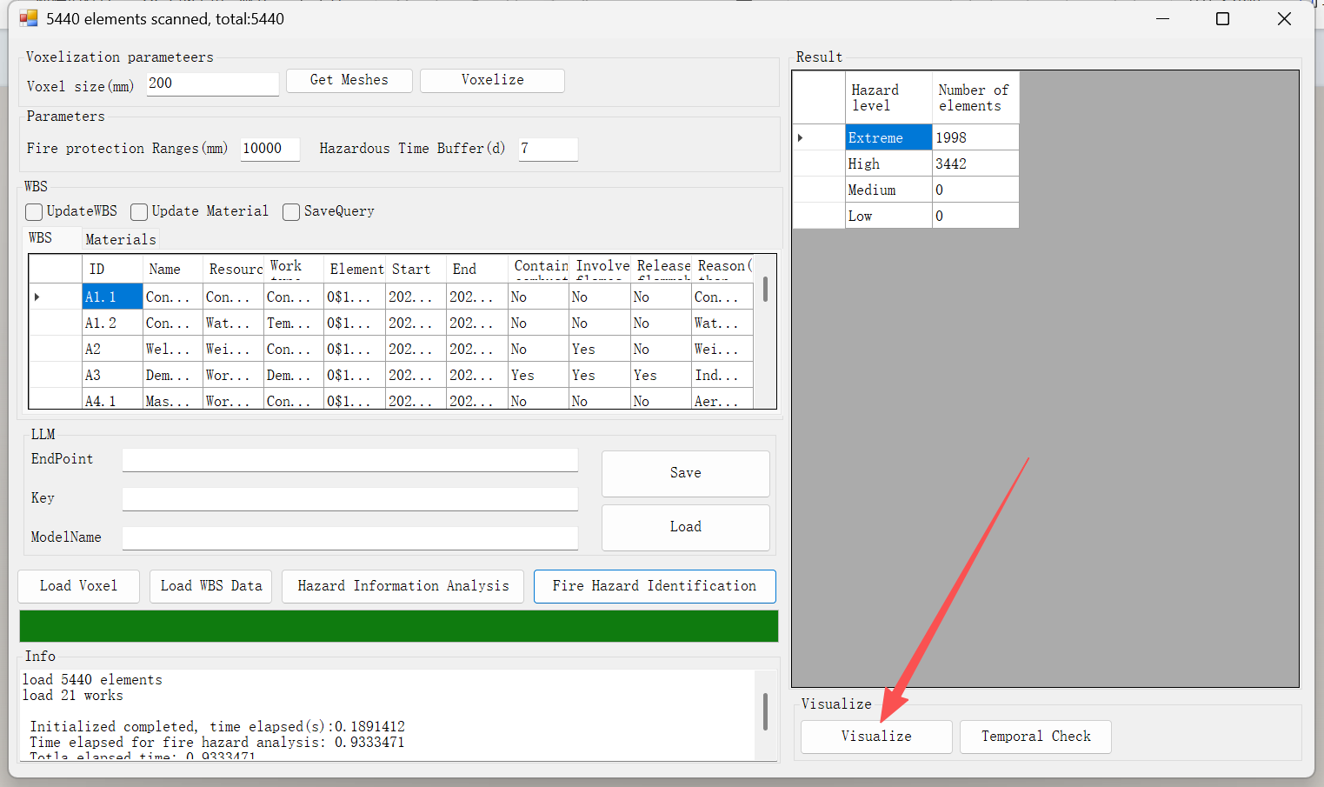
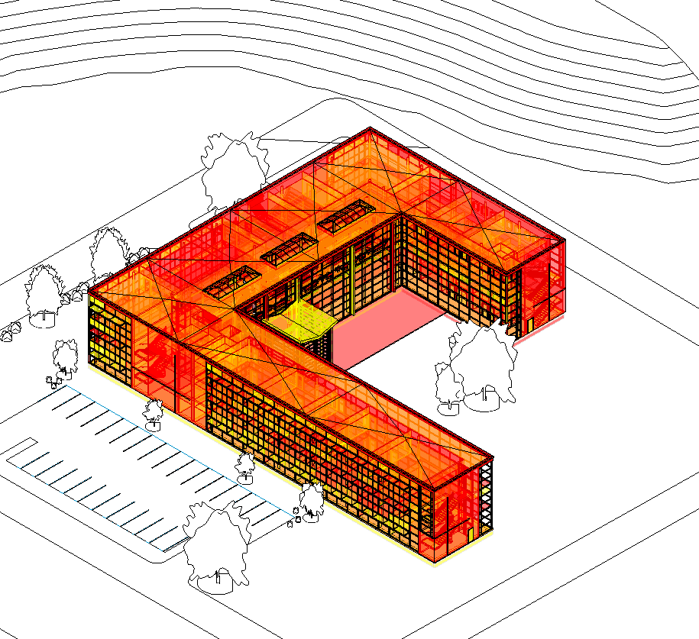
Running the tool
5th Click “Visualize” to check the colored representation of the model. Note: Data will only generated on the main model, the linked model, even voxelized, cannot attatch data.

Slide 11
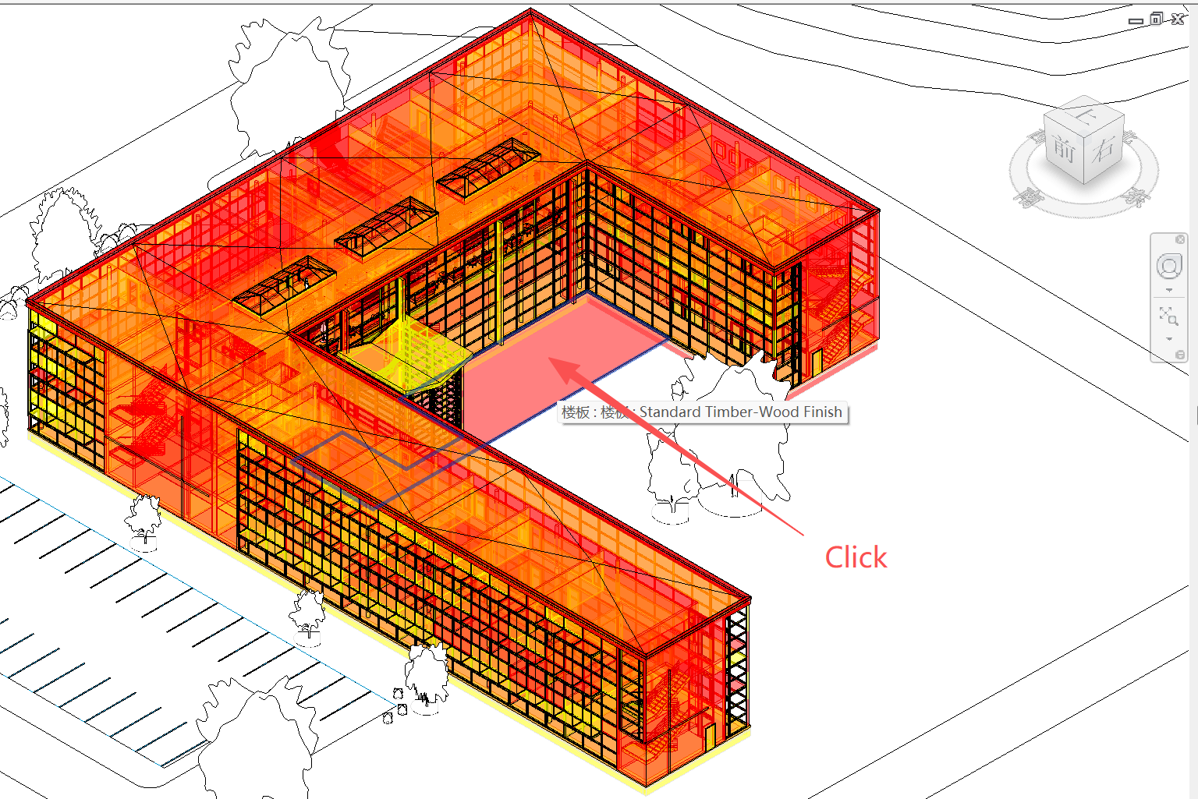
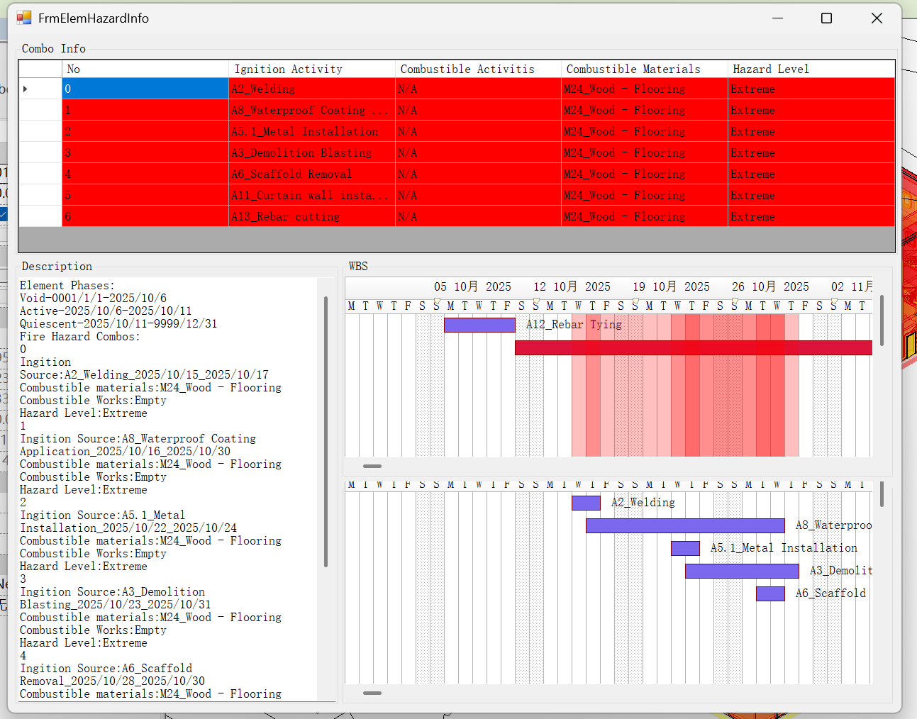
Running the tool
6th Click any element to check its detailed fire hazard information.

Slide 12
Thank you!

